Slide 1

Computer Hardware

Slide 2
Types
Input Unit
Output Unit
Memory Unit
ALU
CPU
Secondary Storage

Slide 3
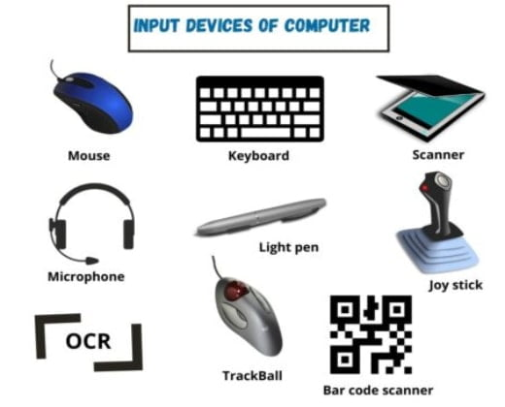
Input Unit
In computer input unit is defined as an input device, a piece of computer hardware apparatus used to supply a data processing system including a computer or information device with control and data signals.

Slide 4
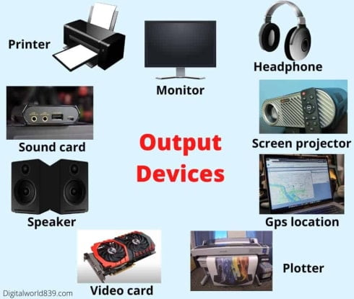
Output Unit
In computers, a unit which delivers information from the computer to an external device or from internal storage to external storage.

Slide 5
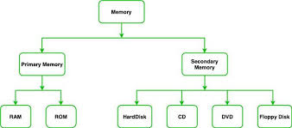
Memory Unit
Memory unit is a component of a computer system. It is used to store data, instructions and information. It is actually a work area of computer, where the CPU stores the data and instruction. It is also known as a main/primary/internal memory.

Slide 6
Arithmetic logic Unit (ALU)
The arithmetic-logic unit (ALU) is that functional part of the digital computer that carries out arithmetic and logic operations on machine words that represent operands. It is usually a part of the central processing unit

Slide 7
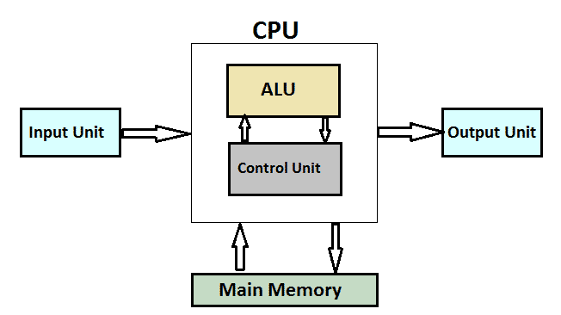
Central Processing Unit
Central Processing Unit is 'the brain of the computer' and takes all the major decisions in a computer system. CPU consists of three main components. The functions of these components are as follows:
Arithmetic and Logic Unit(ALU) — All the arithmetical and logical operations are performed through this unit. An arithmetical operation includes addition, subtraction, multiplication, division and logical operations include all types of comparisons.
Control Unit — This unit controls each and every part of the computer system along with the peripherals. It retrieves data and instructions from the memory and sends the commands to various parts of the computer system.
Memory Unit — This unit provides space for storing data, instructions, intermediate results and final results.

Slide 8
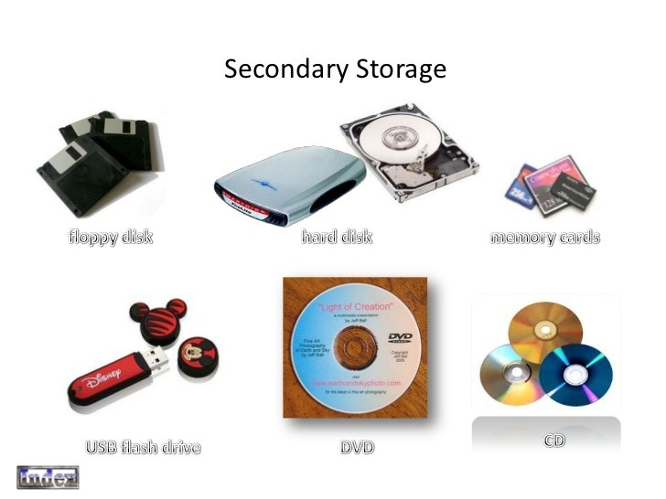
Secondary Storage
Secondary storage is non-volatile, long-term storage. Without secondary storage all programs and data would be lost the moment the computer is switched off.
There are three main types of secondary storage in a computer system:
solid state storage devices, such as USB memory sticks
optical storage devices, such as CD, DVD and Blu-ray discs
magnetic storage devices, such as hard disk drives

Slide 9

Thank you

